Slide 1

Cloud Application Development - Group 5
Project Title: Chatbot with Watson

Slide 2
Persona Design
What is a Chatbot Persona?
•A chatbot persona is like the soul of your chatbot, a carefully crafted character that embodies the tone, voice, and personality of your virtual assitant.
•It's the secret sauce that turns a robotic interaction into a delightful and engaging conversation with a best friend.
•Think of it as an actor playing a role – the chatbot persona sets the stage for how your chatbot interacts with users and represents your brand.
Name: Helpybot
Tone: Friendly, casual and Professional
Style: Rule-based, Retrival-based and Generative Chatbot
Communication: Text messages

Slide 3
Why use a Chatbot Persona?
Chatbots automate workflows and free up employees from repetitive tasks. A chatbot can also eliminate long wait times for phone-based customer support, or even longer wait times for email, chat and web-based support, because they are available immediately to any number of users at once.

Slide 4
User Scenarios
Chatbot use cases in customer service
1. Chatbots answer questions and inquiries
2.Book tickets to events/shows with chatbots
3. Use chatbots to find products, check inventory and recommend items
4.Chatbots to build remarkable customer experience

Slide 5
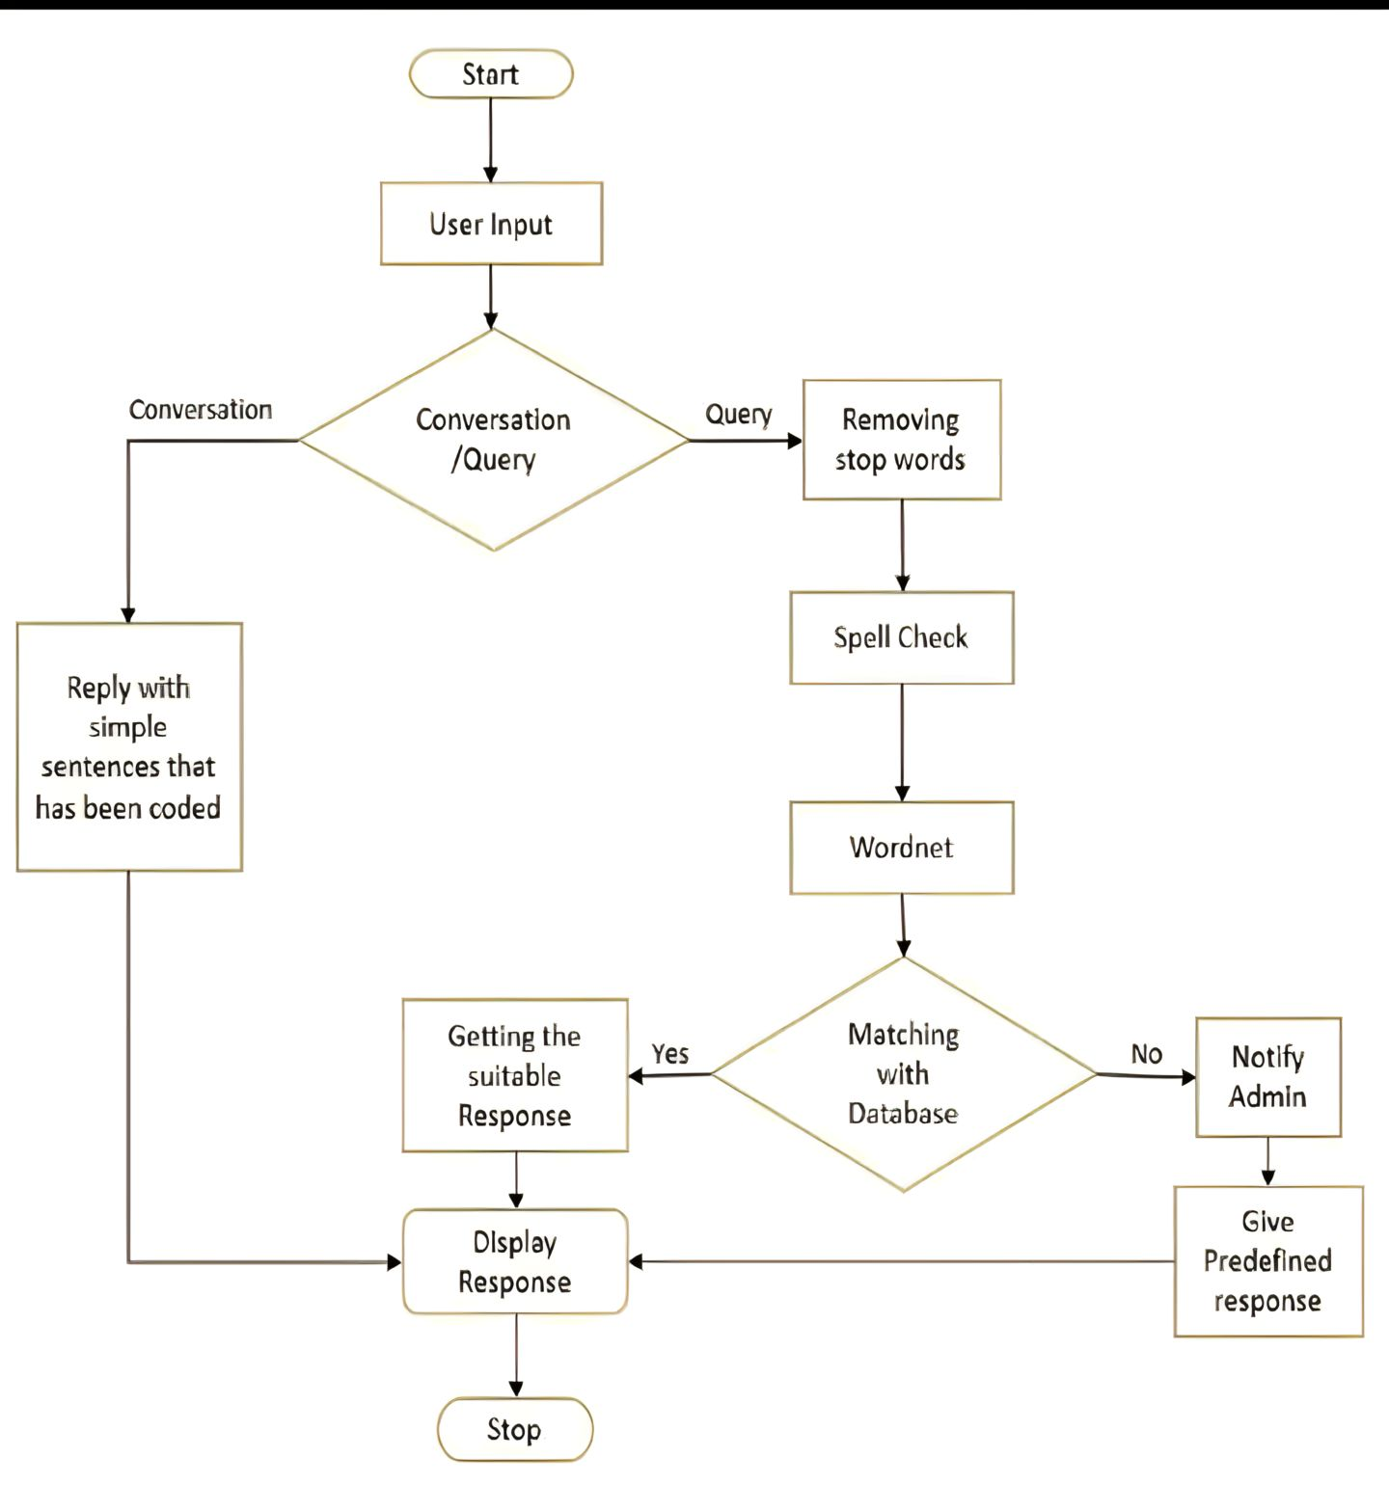
Conversation Flow
Conversation Flow

Slide 6
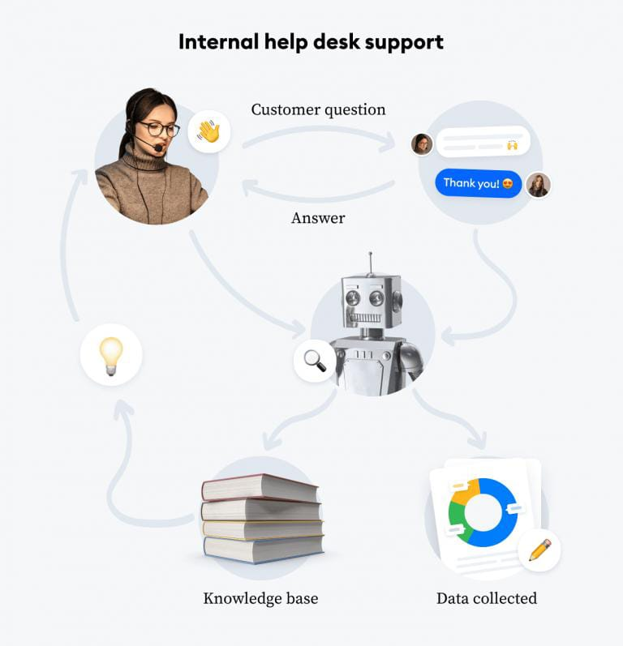
Response Configuration
We use Machine learning algorithm to give response to the user’s question.
The response configuration deals with the:
Basic information query
Specific service Inquery
Booking for Apponitment
Handling complaints
FAQs
Technical support
Closing the conversation

Slide 7
Platform Integration
Integration of chatbots in social media enhances user engagement, automates repetitive tasks, and improves overall customer experience.
Customer Service: Chatbots handle customer inquiries, complaints, and support requests, providing quick and automated responses.
Lead Generation: Chatbots engage with users, collect their information, and qualify leads for businesses to follow up.
Content Distribution: Chatbots share content, updates, and links to articles, helping businesses reach a wider audience.
Appointment Booking: Chatbots assist in scheduling appointments, reservations, or consultations, streamlining the booking process.
Surveys and Feedback: Chatbots gather feedback, conduct surveys, and analyze user responses to help businesses improve their products or services.

Slide 8
E-commerce Assistance: Chatbots guide users in browsing products, making purchases, and answering product-related questions.
Event Promotion and RSVPs: Chatbots promote events, manage RSVPs, and provide event-related information to users.
Educational Content Delivery: Chatbots deliver educational content, tutorials, and answer queries related to a specific topic or subject.
Entertainment and Games: Chatbots offer entertainment through interactive games, quizzes, or storytelling to keep users engaged.
Community Building: Chatbots facilitate community engagement by starting conversations, moderating discussions, and promoting community events.

Slide 9
User Experience
A chatbot persona can work wonders for your chatbot's user experience.
•Natural Conversations: A well-crafted persona makes chatbot conversations feel more natural and less robotic, creating a delightful user experience.
•Emotional Connection: By giving your chatbot a relatable personality, users are more likely to form an emotional connection with your virtual assistant, making them more likely to come back for more interactions.
•Entertaining and Engaging: A witty and playful chatbot persona can add a touch of humor and entertainment to mundane tasks, keeping users engaged and hooked.

